Slide 1
Spectral analysis and filtering
Lecture 7

Slide 2
The Big Picture
Time series analysis
Time Domain
ARIMA models
GARCH models
Transfer function models
Frequency domain
Spectral estimation
Filtering
Can be applied to same kind of data!

Slide 3
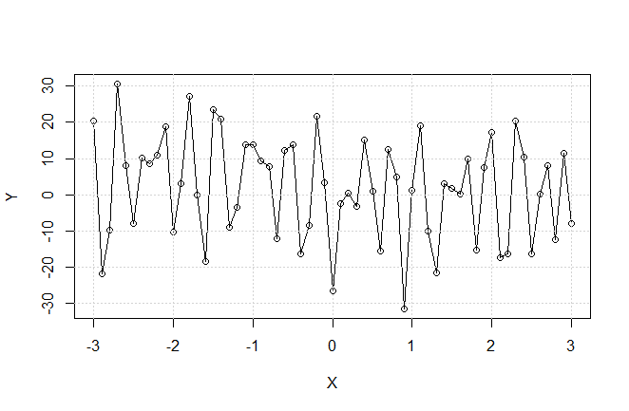
Frequency domain: example
$$Y=4\cos\left(X+2\right)+13\cos\left(20X+4\right)+20\cos\left(0.2X+1\right)+13\cos\left(0.5X−4\right)+N(0,0.5)$$
No sin() or cos() are evident from the picture
Can we restore original frequencies?
Can we account for the noise?

Slide 4
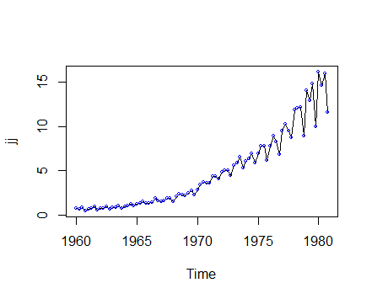
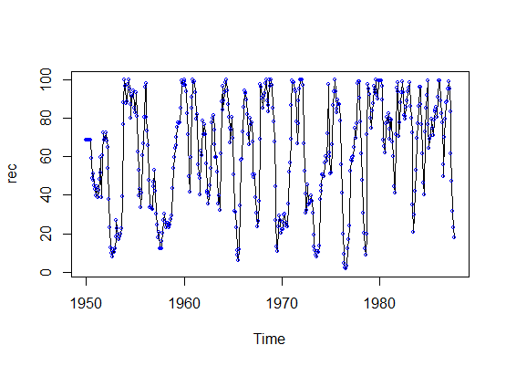

Frequency and period
Period $d$ =points per cycle
Frequency $w=\frac{1}{d}$
What is highest possible $w$? $w=0.5$ is folding frequency
Example What is d and w for Johnson&Johnson and Recruitment?

Slide 5

Single frequency model
$$x_{t}=Acos(2πwt+φ)$$
Assumptions:
$A$ is random variable (amplitude)
$φ$ is random variable (phase)
$A$ ,$φ$ independent
$w$ nonrandom (frequency)

Slide 6
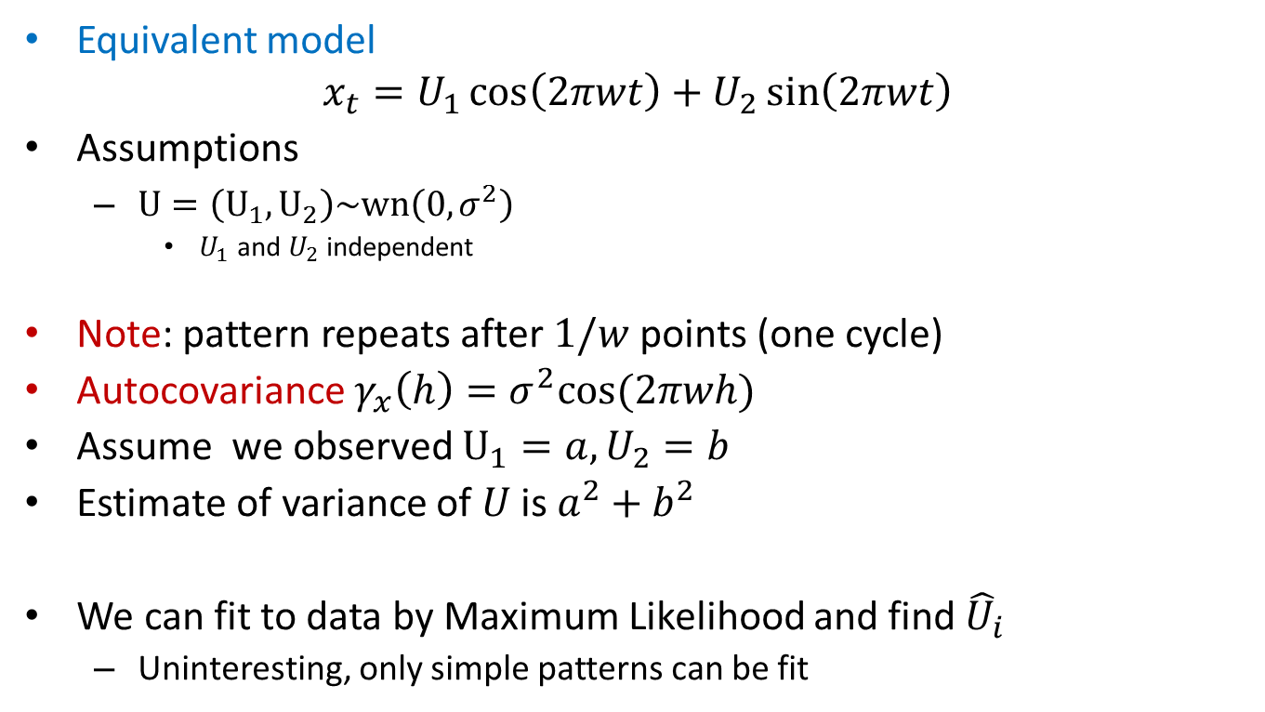
Single frequency model
Equivalent model
$$x_{t}=U_{1}\cos\left(2πwt\right)+U_{2}\sin\left(2πwt\right)$$
Assumptions
$U=\left(U_{1},U_{2}\right)\sim wn\left(0,σ^{2}\right)$
$U_{1}$ and $U_{2}$ independent
Note: pattern repeats after $1/w$ points (one cycle)
Autocovariance $γ_{x}\left(h\right)=σ^{2}cos⁡(2πwh)$
Assume we observed $U_{1}=a, U_{2}=b$
Estimate of variance of $U$ is $a^{2}+b^{2}$
We can fit to data by Maximum Likelihood and find ${\hat{U}}_{i}$
Uninteresting, only simple patterns can be fit

Slide 7
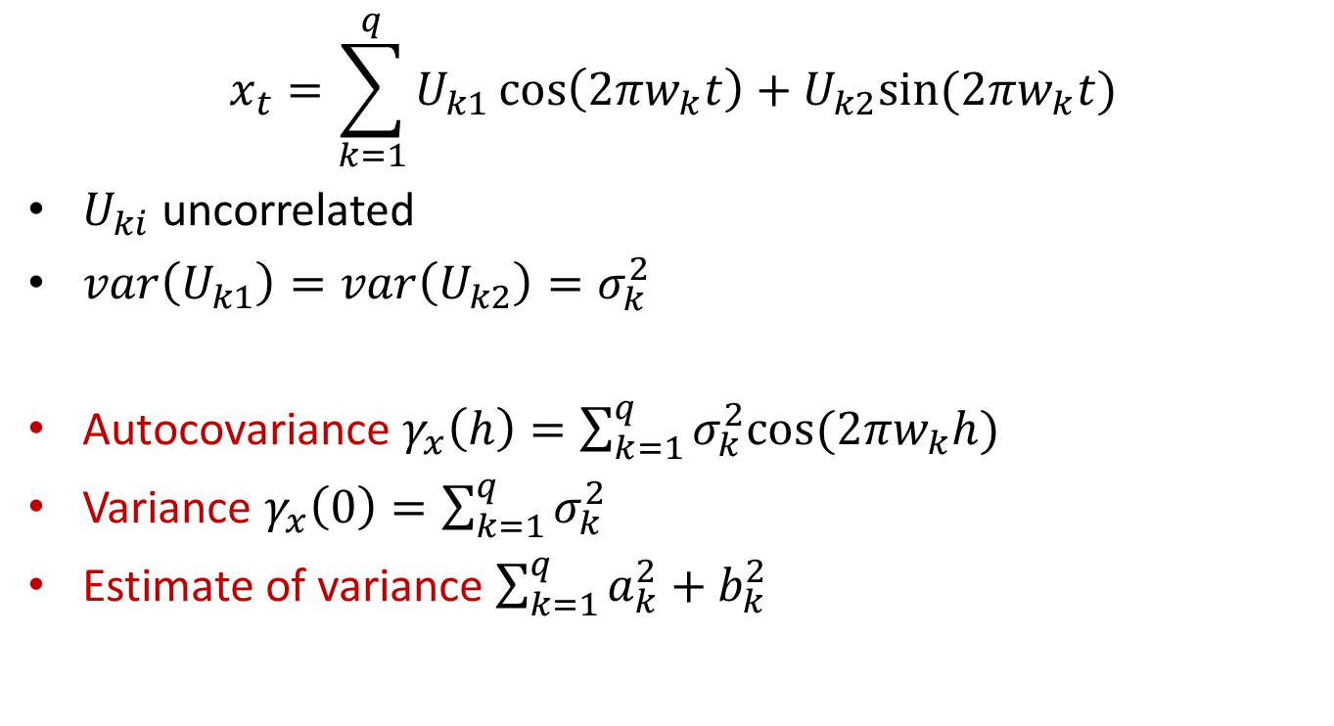
Multiple frequency model
$$x_{t}=\sum_{k=1}^{q}{U_{k1}\cos\left(2πw_{k}t\right)+U_{k2}sin⁡(2πw_{k}t)}$$
$U_{ki}$ uncorrelated
$var\left(U_{k1}\right)=var\left(U_{k2}\right)=σ_{k}^{2}$
Autocovariance $γ_{x}\left(h\right)=\sum_{k=1}^{q}{σ_{k}^{2}cos⁡(2πw_{k}h) }$
Variance $γ_{x}\left(0\right)=\sum_{k=1}^{q}{σ_{k}^{2}}$
Estimate of variance $\sum_{k=1}^{q}{a_{k}^{2}+b_{k}^{2}}$

Slide 8
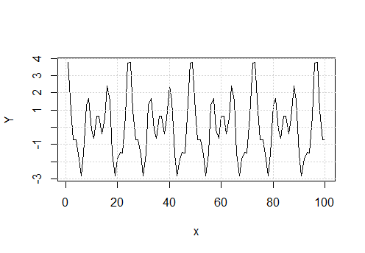
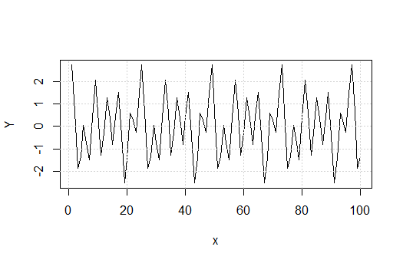

Multiple frequency model
Example: $σ^{2}=1, k=3, w_{i}=\frac{1}{4i}$
Problem: to estimate model from data, we need to know $w_{i}$ but we don’t

Slide 9
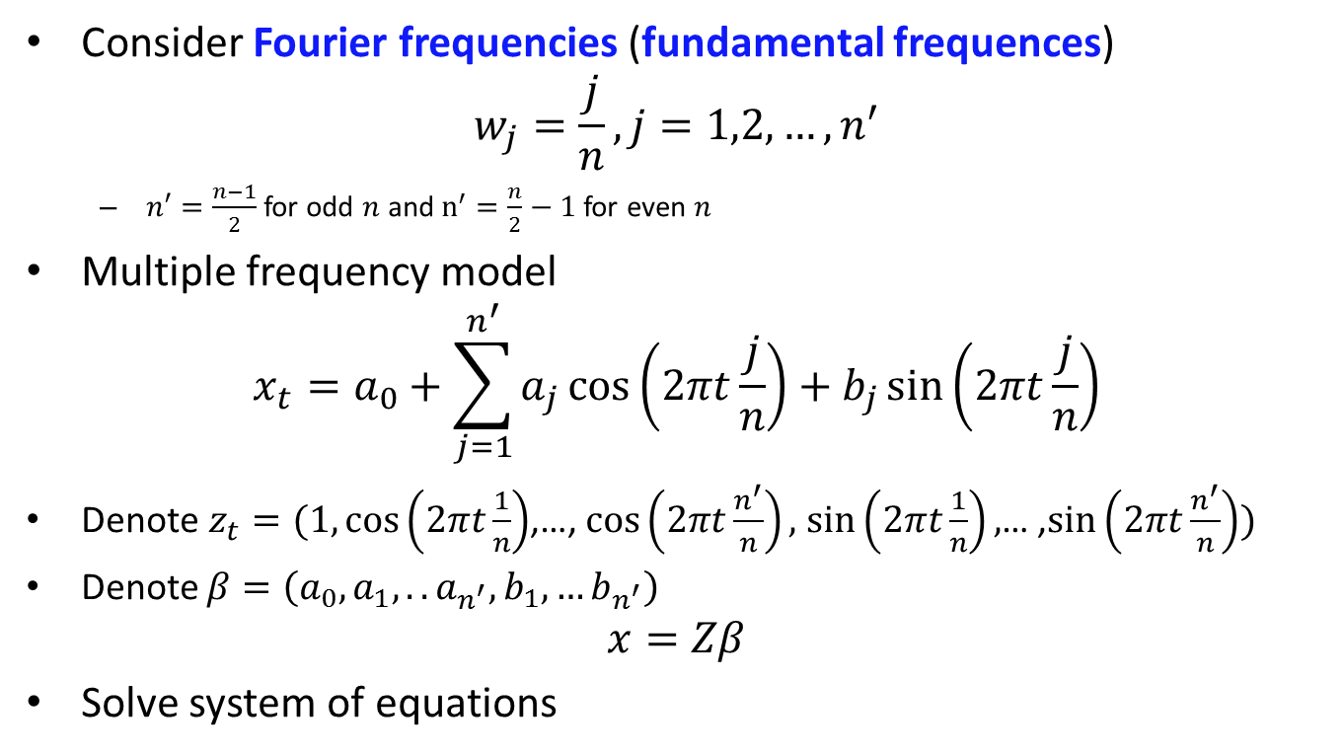
Estimation
Consider Fourier frequencies (fundamental frequences)
$$w_{j}=\frac{j}{n}, j=1,2,…,n^{′}$$
$n′=\frac{n−1}{2}$ for odd $n$ and $n^{′}=\frac{n}{2}−1$ for even $n$
Multiple frequency model
$$x_{t}=a_{0}+\sum_{j=1}^{n^{′}}{a_{j}\cos\left(2πt\frac{j}{n}\right)+b_{j}\sin\left(2πt\frac{j}{n}\right)}$$
Denote $z_{t}=(1,\cos\left(2πt\frac{1}{n}\right)$,…, $\cos\left(2πt\frac{n^{′}}{n}\right),$ $\sin\left(2πt\frac{1}{n}\right),$… ,$\sin\left(2πt\frac{n^{′}}{n}\right))$
Denote $β=\left({a_{0}, a}_{1},..a_{n^{′}},b_{1},…b_{n^{′}}\right)$
$$x=Zβ$$
Solve system of equations

Slide 10
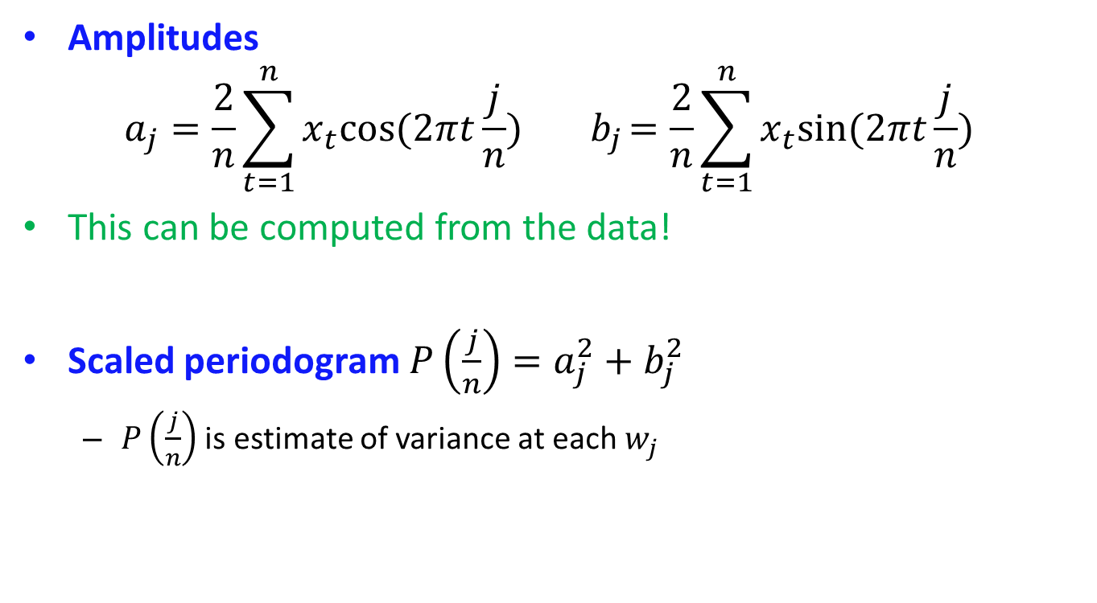
Estimation
Amplitudes
$$a_{j}=\frac{2}{n}\sum_{t=1}^{n}{x_{t}cos⁡(2πt}\frac{j}{n}){ b}_{j}=\frac{2}{n}\sum_{t=1}^{n}{x_{t}sin⁡(2πt}\frac{j}{n})$$
This can be computed from the data!
Scaled periodogram $P\left(\frac{j}{n}\right)=a_{j}^{2}+b_{j}^{2}$
$P\left(\frac{j}{n}\right)$ is estimate of variance at each $w_{j}$

Slide 11
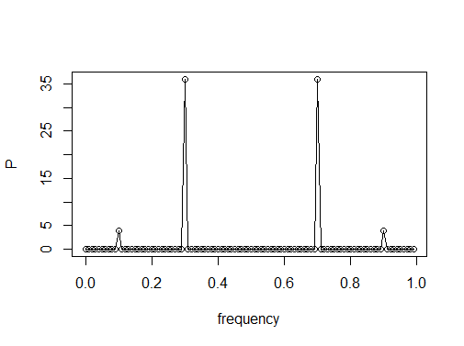

Estimation
Example $x_{t}=2\cos\left(2πt⋅0.1\right)+6\sin\left(2πt⋅0.3\right), n=100$
Which frequences extracted?
Are P’s correct?
Always symmetric around 0.5

Slide 12
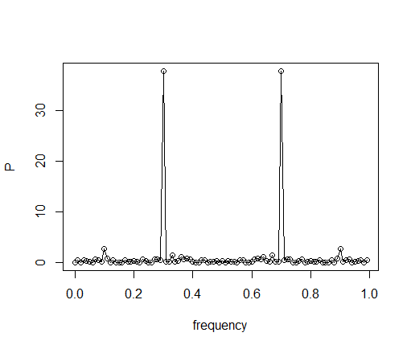

Estimation
Example $x_{t}=2\cos\left(2πt⋅0.1\right)+6\sin\left(2πt⋅0.3\right)+N(0,9) , n=100$
Changes?
Simple approach:
1) filter out the periodogram
2) Compose a model from the remaining frequences
3) Make forecasting by Inverse Fourier Transform

Slide 13
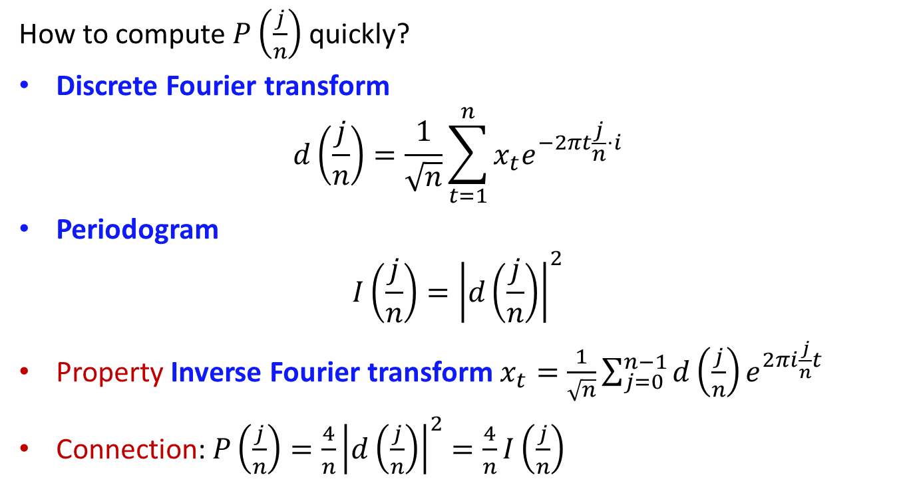
Estimation
How to compute $P\left(\frac{j}{n}\right)$ quickly?
Discrete Fourier transform
$$d\left(\frac{j}{n}\right)=\frac{1}{\sqrt{n}}\sum_{t=1}^{n}{x_{t}e^{−2πt\frac{j}{n}⋅i}}$$
Periodogram
$$I\left(\frac{j}{n}\right)={\left|d\left(\frac{j}{n}\right)\right|}^{2}$$
Property Inverse Fourier transform $x_{t}=\frac{1}{\sqrt{n}}\sum_{j=0}^{n−1}{d\left(\frac{j}{n}\right)e^{2πi\frac{j}{n}t}}$
Connection: $P\left(\frac{j}{n}\right)=\frac{4}{n}{\left|d\left(\frac{j}{n}\right)\right|}^{2}=\frac{4}{n}I\left(\frac{j}{n}\right)$

Slide 14
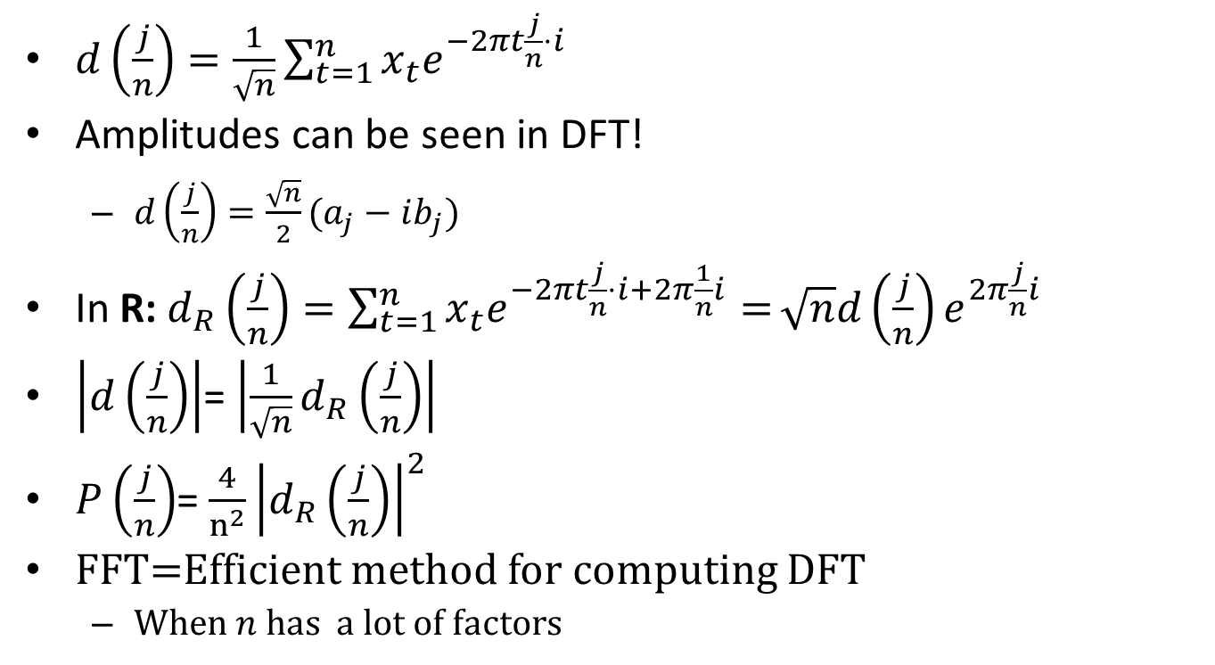
Discrete Fourier Transform
$d\left(\frac{j}{n}\right)=\frac{1}{\sqrt{n}}\sum_{t=1}^{n}{x_{t}e^{−2πt\frac{j}{n}⋅i}}$
Amplitudes can be seen in DFT!
$d\left(\frac{j}{n}\right)=\frac{\sqrt{n}}{2}(a_{j}−ib_{j})$
In R: $d_{R}\left(\frac{j}{n}\right)=\sum_{t=1}^{n}{x_{t}e^{−2πt\frac{j}{n}⋅i+2π\frac{1}{n}i}=}\sqrt{n}d\left(\frac{j}{n}\right)e^{2π\frac{j}{n}i}$
$\left|d\left(\frac{j}{n}\right)\right|$= $\left|\frac{1}{\sqrt{n}}d_{R}\left(\frac{j}{n}\right)\right|$
$P\left(\frac{j}{n}\right)$= $\frac{4}{n^{2}}{\left|d_{R}\left(\frac{j}{n}\right)\right|}^{2}$
FFT=Efficient method for computing DFT
When $n$ has a lot of factors

Slide 15
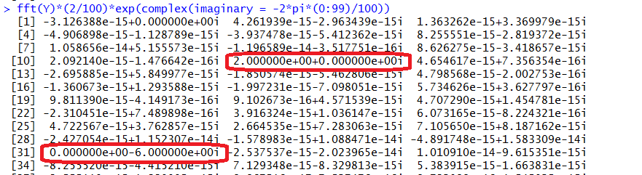
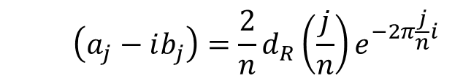
Fast Fourier Transform
Example $x_{t}=2\cos\left(2πt⋅0.1\right)+6\sin\left(2πt⋅0.3\right), n=100$
$$\left(a_{j}−ib_{j}\right)={\frac{2}{n}d}_{R}\left(\frac{j}{n}\right)e^{−2π\frac{j}{n}i}$$
Frequencies starts from 0/n

Slide 16

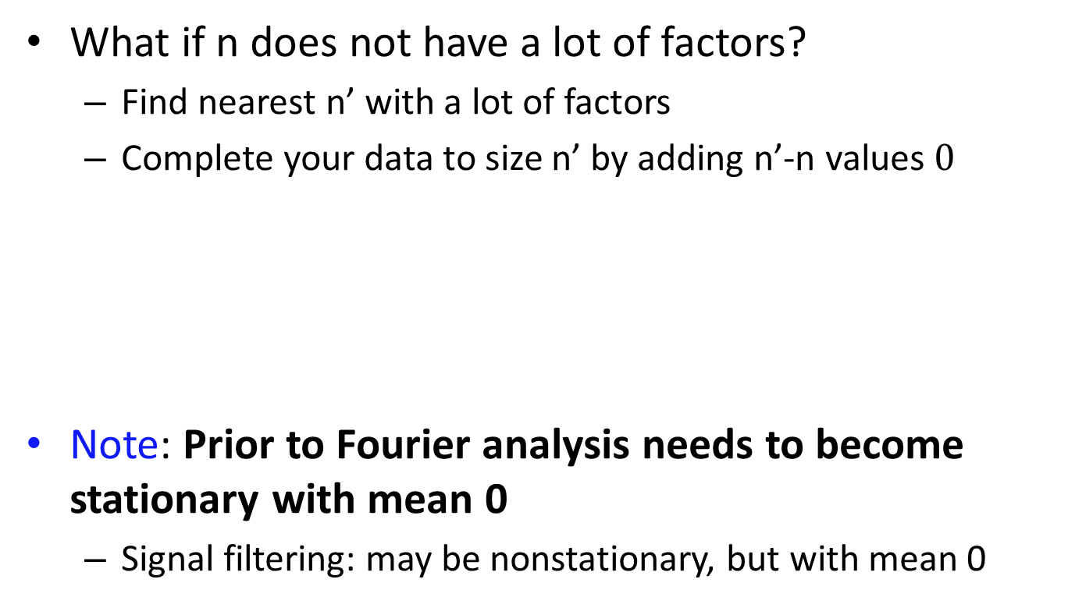
Fast Fourier Transform
What if n does not have a lot of factors?
Find nearest n’ with a lot of factors
Complete your data to size n’ by adding n’-n values $0$
Note: Prior to Fourier analysis needs to become stationary with mean 0
Signal filtering: may be nonstationary, but with mean 0

Slide 17
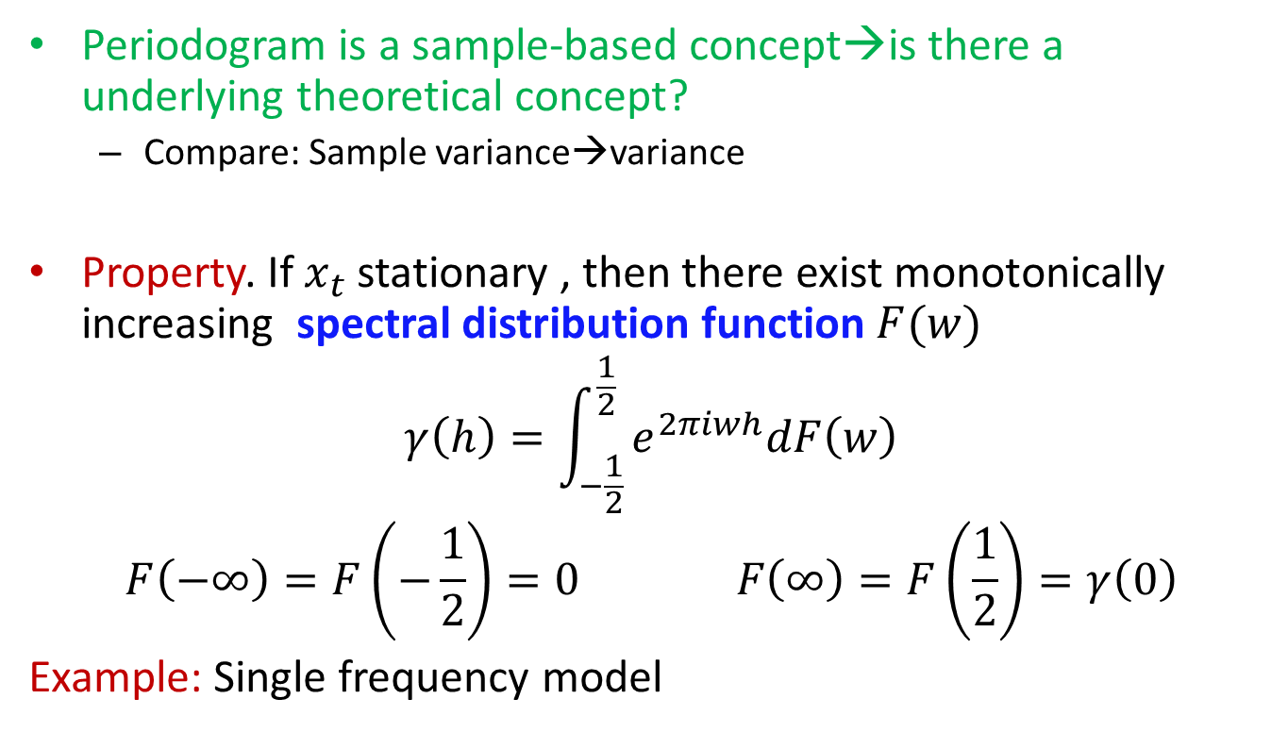
Spectral distribution function
Periodogram is a sample-based concept→is there a underlying theoretical concept?
Compare: Sample variance→variance
Property. If $x_{t}$ stationary , then there exist monotonically increasing spectral distribution function $F(w)$
$$γ\left(h\right)=\int_{−\frac{1}{2}}^{\frac{1}{2}}{e^{2πiwh}dF\left(w\right)}$$
$$F\left(−∞\right)=F\left(−\frac{1}{2}\right)=0 F\left(∞\right)=F\left(\frac{1}{2}\right)=γ\left(0\right)$$
Example: Single frequency model

Slide 18
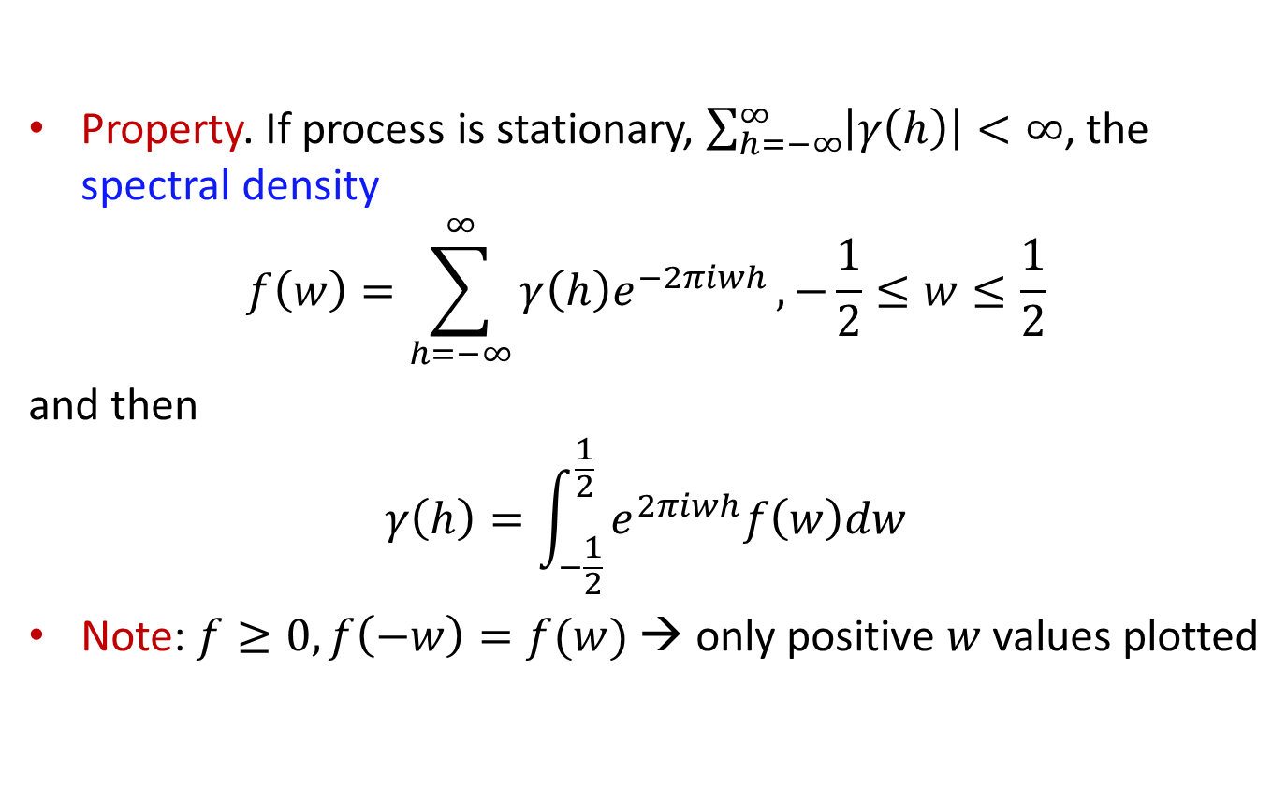
Spectral density
Property. If process is stationary, $\sum_{h=−∞}^{∞}{\left|γ\left(h\right)\right|<∞}$, the spectral density
$$f\left(w\right)=\sum_{h=−∞}^{∞}{γ\left(h\right)e^{−2πiwh}}, −\frac{1}{2}≤w≤\frac{1}{2}$$
and then
$$γ\left(h\right)=\int_{−\frac{1}{2}}^{\frac{1}{2}}{e^{2πiwh}f\left(w\right)dw}$$
Note: $f≥0, f\left(−w\right)=f(w)$ → only positive $w$ values plotted

Slide 19
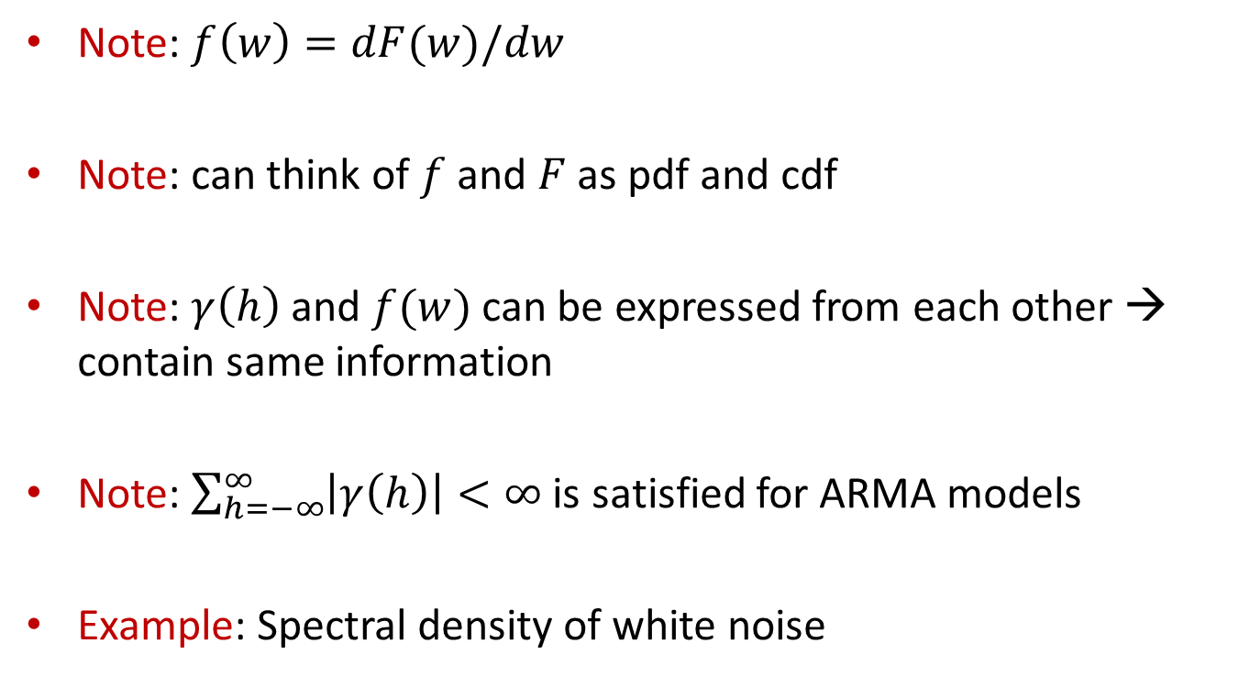
Spectral density
Note: $f\left(w\right)=dF(w)/dw$
Note: can think of $f$ and $F$ as pdf and cdf
Note: $γ\left(h\right)$ and $f(w)$ can be expressed from each other → contain same information
Note: $\sum_{h=−∞}^{∞}{\left|γ\left(h\right)\right|<∞}$ is satisfied for ARMA models
Example: Spectral density of white noise

Slide 20
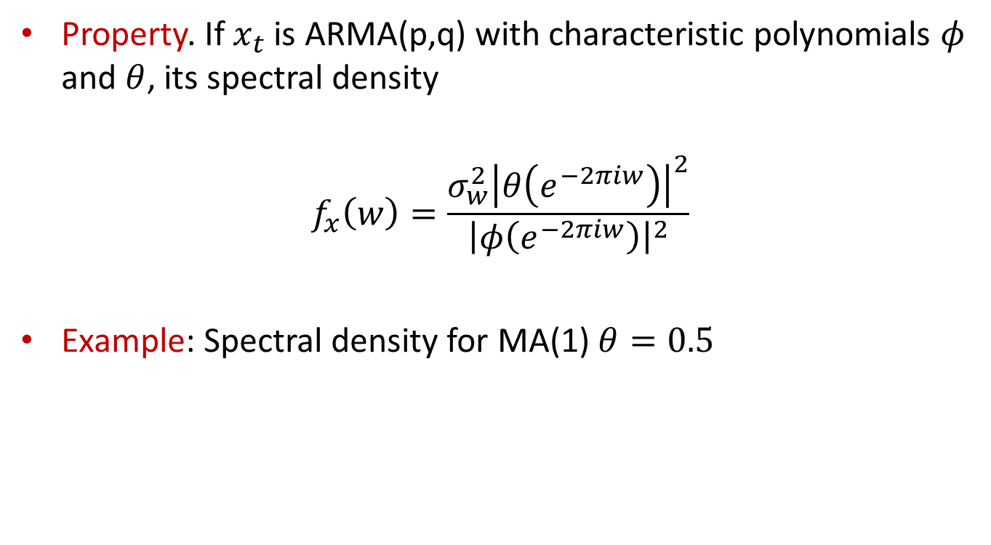
Spectral density of ARMA
Property. If $x_{t}$ is ARMA(p,q) with characteristic polynomials $φ$ and $θ$, its spectral density
$$f_{x}\left(w\right)=\frac{σ_{w}^{2}{\left|θ\left(e^{−2πiw}\right)\right|}^{2}}{{\left|φ\left(e^{−2πiw}\right)\right|}^{2}}$$
Example: Spectral density for MA(1) $θ=0.5$

Slide 21
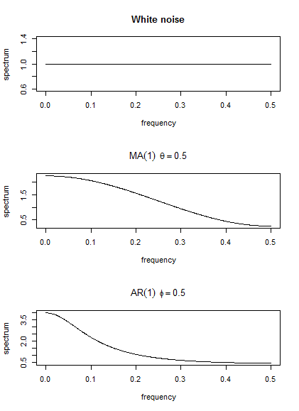
Spectral density of ARMA

Slide 22
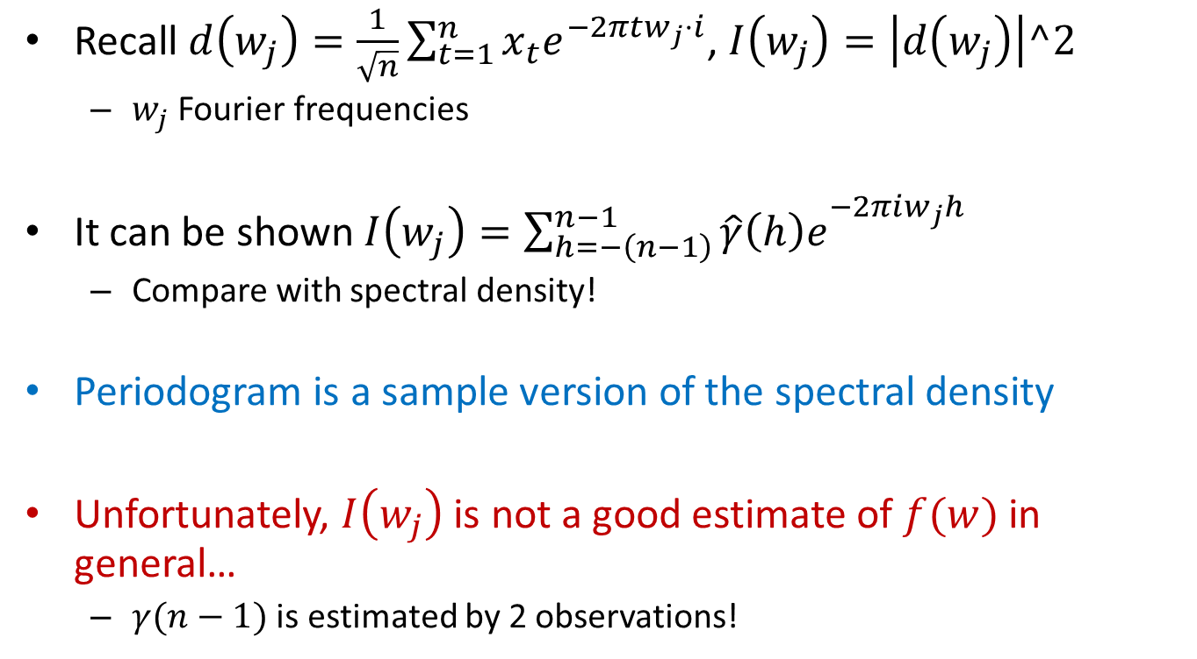
Spectral density and periodogram
Recall $d\left(w_{j}\right)=\frac{1}{\sqrt{n}}\sum_{t=1}^{n}{x_{t}e^{−2πtw_{j}⋅i}}$, $I\left(w_{j}\right)=\left|d\left(w_{j}\right)\right|^2$
$w_{j}$ Fourier frequencies
It can be shown $I\left(w_{j}\right)={\sum_{h=−\left(n−1\right)}^{n−1}{\hat{γ}\left(h\right)e}}^{−2πiw_{j}h}$
Compare with spectral density!
Periodogram is a sample version of the spectral density
Unfortunately, $I\left(w_{j}\right)$ is not a good estimate of $f(w)$ in general…
$γ(n−1)$ is estimated by 2 observations!

Slide 23
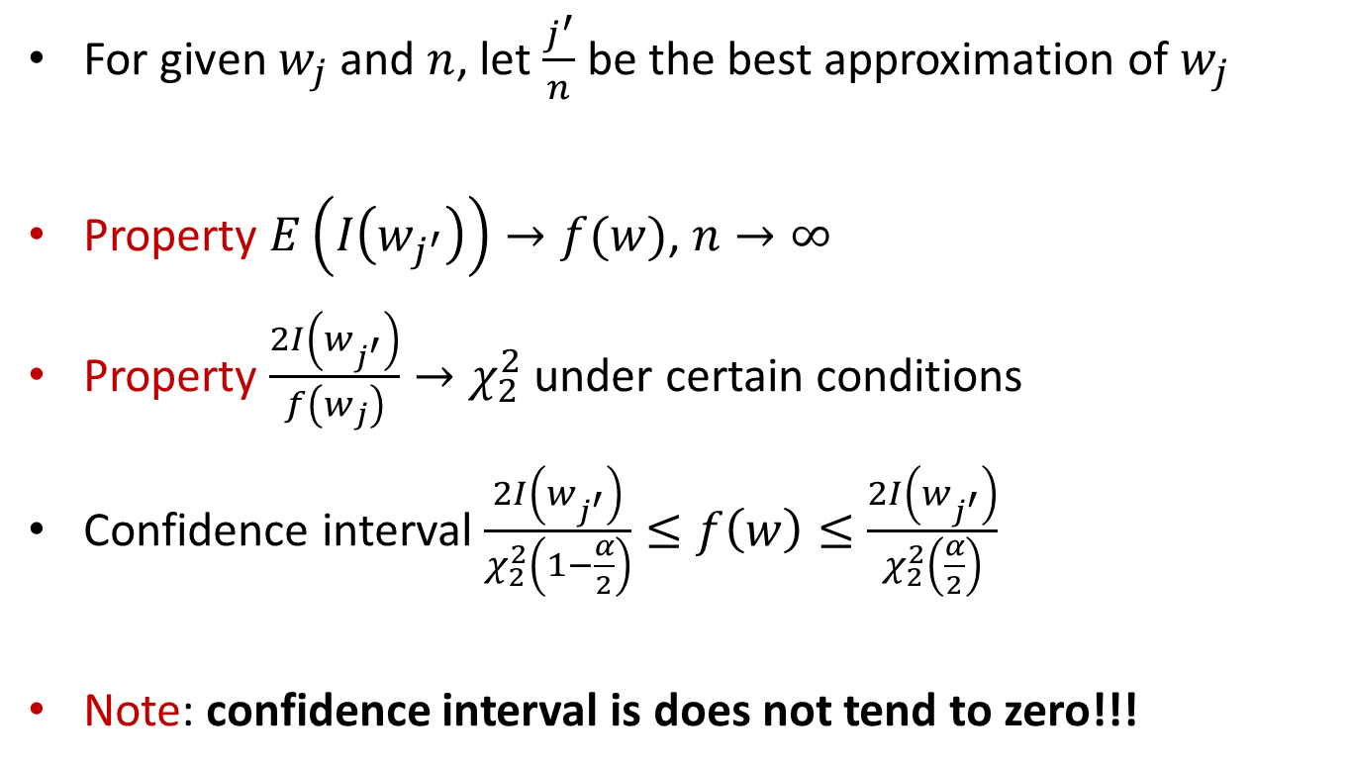
Large sample properties of periodogram
For given $w_{j}$ and $n$, let $\frac{j^{′}}{n}$ be the best approximation of $w_{j}$
Property $E\left(I\left(w_{j^{′}}\right)\right)→f(w)$, $n→∞$
Property $\frac{2I\left(w_{j^{′}}\right)}{f\left(w_{j}\right)}→χ_{2}^{2}$ under certain conditions
Confidence interval $\frac{2I\left(w_{j^{′}}\right)}{χ_{2}^{2}\left(1−\frac{α}{2}\right)}≤f\left(w\right)≤$ $\frac{2I\left(w_{j^{′}}\right)}{χ_{2}^{2}\left(\frac{α}{2}\right)}$
Note: confidence interval is does not tend to zero!!!

Slide 24
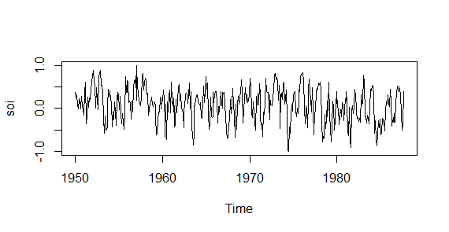
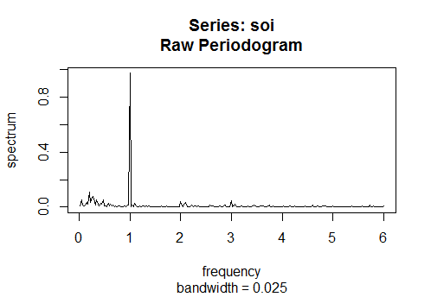
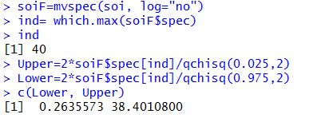
Large sample properties of periodogram
Example: SOI series

Slide 25
Better estimates
Periodogram is not a consistent estimator of the spectral density
CI does not shrunk
Better estimators than periodogram?
Alternative A: No assumption about the underlying model→nonparametric spectral estimation
Alternative B: Assume a model (ARMA)→ parametric spectral estimation

Slide 26
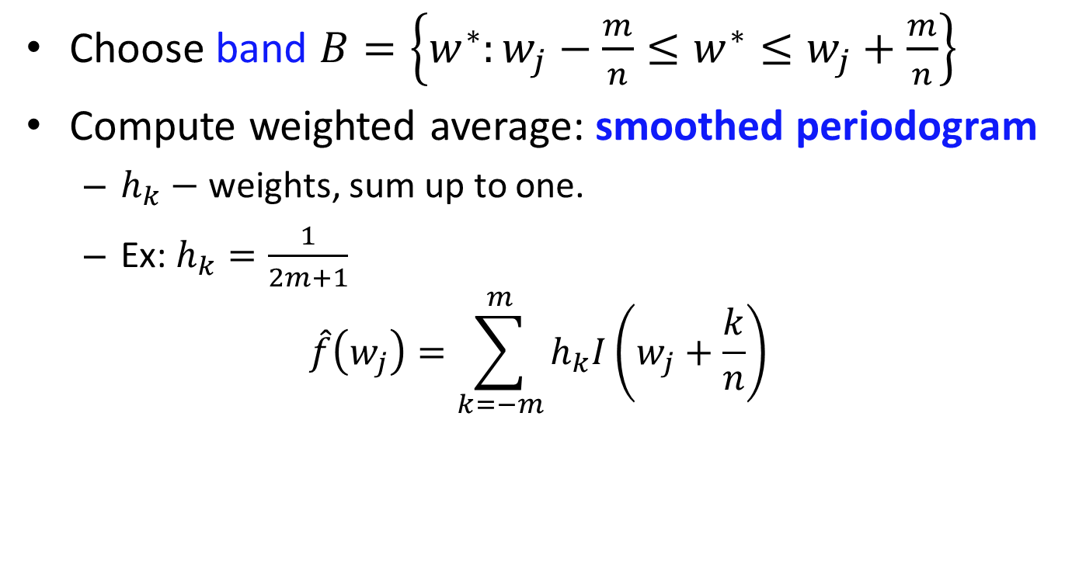
Nonparametric spectral estimation
Choose band $B=\left\{w^{∗}:w_{j}−\frac{m}{n}≤w^{∗}≤w_{j}+\frac{m}{n}\right\}$
Compute weighted average: smoothed periodogram
$h_{k}−$ weights, sum up to one.
Ex: $h_{k}=\frac{1}{2m+1}$
$$\hat{f}\left(w_{j}\right)=\sum_{k=−m}^{m}{h_{k}I\left(w_{j}+\frac{k}{n}\right)}$$

Slide 27
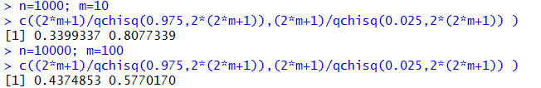

Smoothed periodogram: large sample properties
Confidence interval
$$\frac{2L_{h}\hat{f}\left(w\right)}{χ_{2L_{h}}^{2}\left(1−\frac{α}{2}\right)}≤f\left(w\right)≤\frac{2L_{h}\hat{f}\left(w\right)}{χ_{2L_{h}}^{2}\left(\frac{α}{2}\right)}$$
where $L_{h}=\frac{1}{\sum_{k}{h_{k}^{2}}}$
Bandwidth $B=\frac{L_{h}}{n}$
Example: $h_{k}=\frac{1}{2m+1}$

Slide 28
Smoothed periodogram
Which bandwidth to take?
Take the one over which the spectrum is essentially constant
Too narrow band→too wide confidence intervals
Too wide band→valid peaks will be smoothed out
→Take the smallest band giving good CI and not destroying peaks!

Slide 29
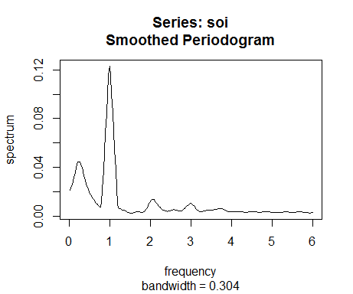
Smoothed periodogram
Example: SOI with Modified Daniell Kernel(3,3)

Slide 30
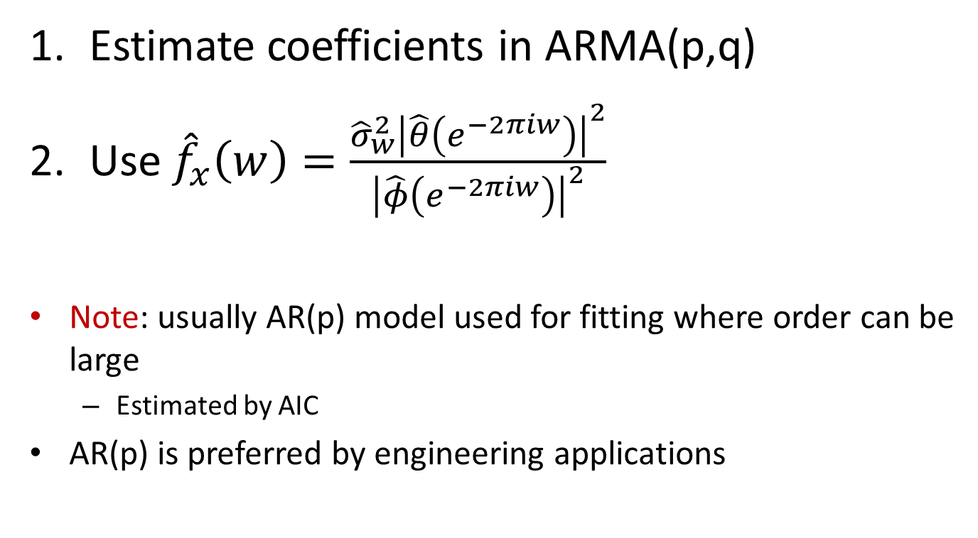
Parametric spectral estimation
Estimate coefficients in ARMA(p,q)
Use ${\hat{f}}_{x}\left(w\right)=\frac{{\hat{σ}}_{w}^{2}{\left|\hat{θ}\left(e^{−2πiw}\right)\right|}^{2}}{{\left|\hat{φ}\left(e^{−2πiw}\right)\right|}^{2}}$
Note: usually AR(p) model used for fitting where order can be large
Estimated by AIC
AR(p) is preferred by engineering applications

Slide 31
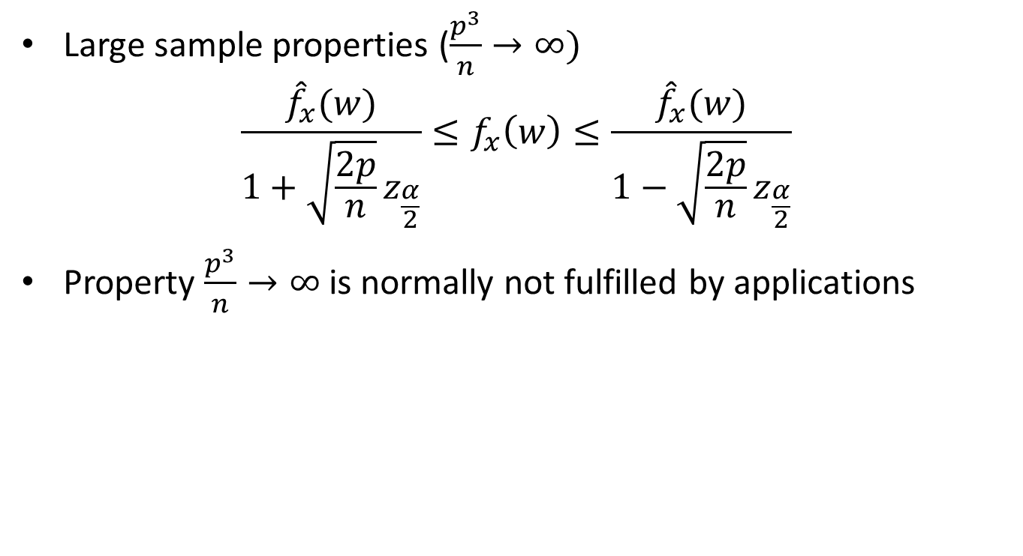
Parametric spectral estimation
Large sample properties ($\frac{p^{3}}{n}→∞)$
$$\frac{{\hat{f}}_{x}(w)}{1+\sqrt{\frac{2p}{n}}z_{\frac{α}{2}}}≤f_{x}\left(w\right)≤\frac{{\hat{f}}_{x}(w)}{1−\sqrt{\frac{2p}{n}}z_{\frac{α}{2}}}$$
Property $\frac{p^{3}}{n}→∞$ is normally not fulfilled by applications

Slide 32
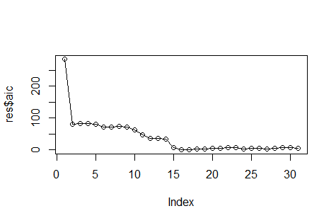
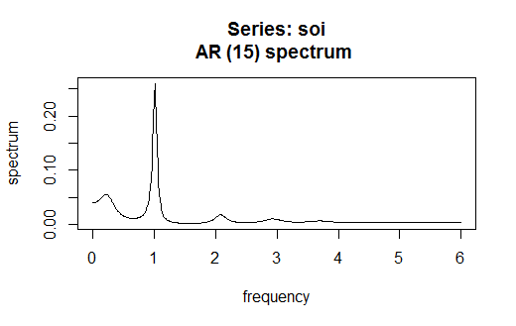
Parametric spectral estimation
Example: SOI series

Slide 33
Spectral density and Machine Learning
Clustering or classification of time series in frequency domain
Estimate frequencies from multiple time series
Filter our noise
Use resulting set of frequences per series as an observation in clustering or classification
Example: discriminate earthquakes and mining explosions (threat monitoring)

Slide 34
Home reading
SS, ch 4.1, 4.2, 4.3 pp. 180-181,186-188, ch.4.4 briefly, ch. 4.5
Fft, arma.spec, mvspec, spec.ar, ar, kernel

